Slide 1
Introduction to Windows and CMD
Windows Administration and Hardening Day 1

Slide 2
Class Objectives
By the end of today’s class, you will be able to:
Leverage the Windows Command Prompt (CMD) to navigate and manage directories and files.
Use wmic and Task Manager to manage processes and retrieve system info.
Create, manage, and view user information using the command-line tool net.
Manage password policies using gpedit.
Schedule tasks using Task Scheduler.

Slide 3
Welcome to Windows

Slide 4

While many IT professionals prefer Mac OS and Linux, Windows is still the leader for desktop
operating systems.
Notes:
Image source: shutterstock_1083618569

Slide 5
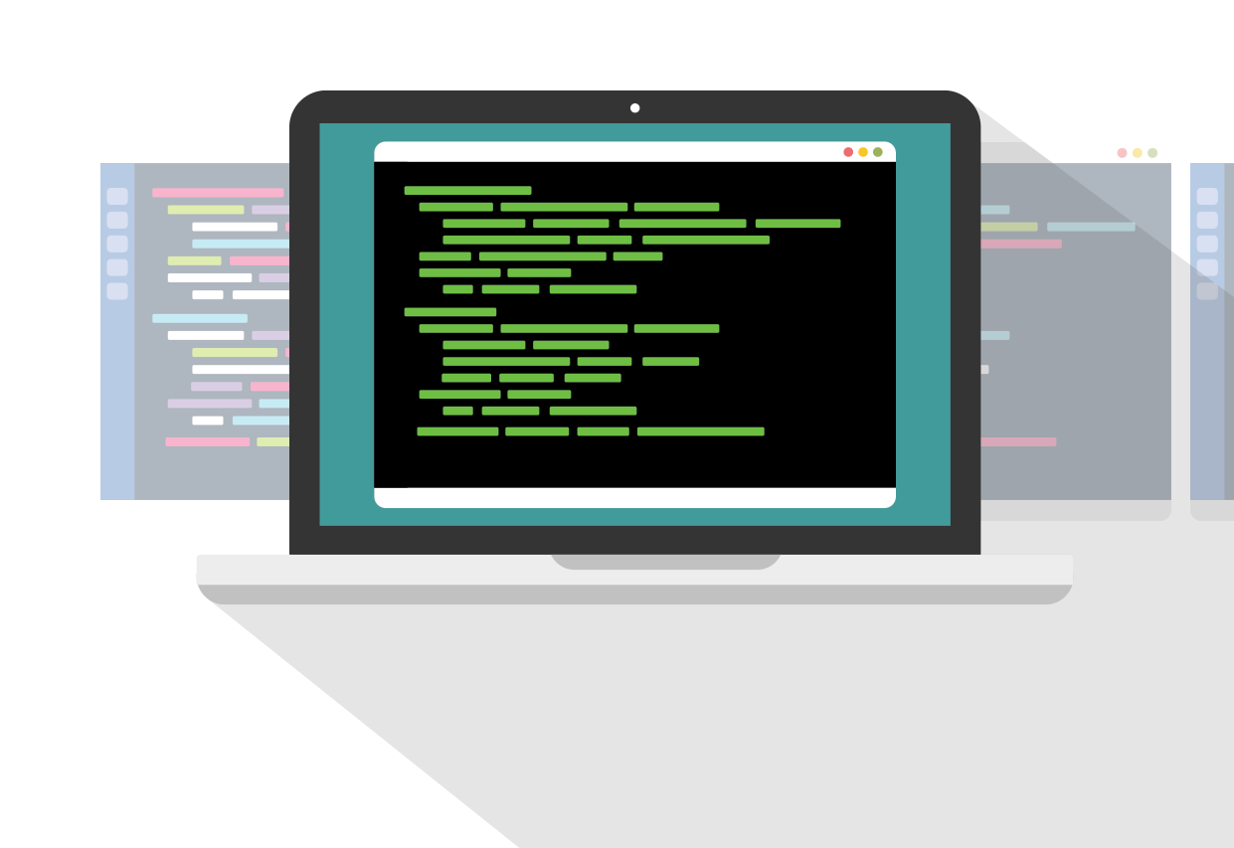
The popularity of Windows machines makes them the most common target for today’s attackers.
Malware can specifically target vulnerabilities in unpatched and unsecure Windows machines and servers.
Notes:
Image source: shutterstock_1278851809

Slide 6
Windows in a Professional Context
Windows knowledge is essential for the following roles, among many others:
SOC Analyst | System Administrator | Penetration Testing | Endpoint Forensics
SOC analysts must monitor and detect suspicious activity on Windows machines. | The large majority of system administrators work with one or many Microsoft products and services: Windows PCs, Windows Servers, Office 365, and Exchange, etc. | Due to Windows’ wide usage by businesses, penetration testers must exploit Windows and Microsoft-related platforms. | Being the most commonly supported endpoint device for businesses, forensics investigators must understand how Windows works.

Slide 7
Windows System Administrator
Today we will complete common system administration tasks using command-line and GUI tools to troubleshoot a problematic Windows PC.
Audit processes with Task Manager.
Use the command line to gather info and create files.
Enforce password policies.
Manage users.
Automate tasks.

Slide 8

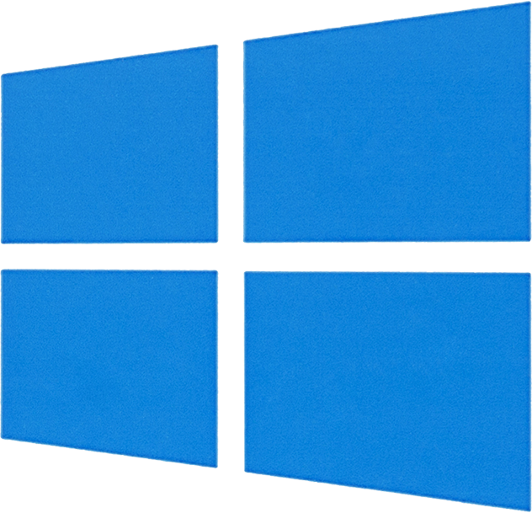
Learning Windows
Today, we’ll learn the “Windows way” of performing basic sysadmin tasks.
We’ve already learned how to do many of these tasks on Linux.
Since the topics covered today are similar to Linux, we will move quickly and emphasize the syntax and OS differences for completing tasks in Windows.
Notes:
shutterstock_419292739

Slide 9
Launching Your Windows Lab

Slide 10

Before we get started, let’s take a moment to log into and launch our Azure Lab environment.
10

Slide 11
Introduction to Task Manager

Slide 12

Did you notice the excessive number of processes that started up when you logged into the Windows 10 VM?
This is what a Windows workstation can look like if not maintained by an organization’s system administrator.
12
Notes:
shutterstock_1229109085

Slide 13
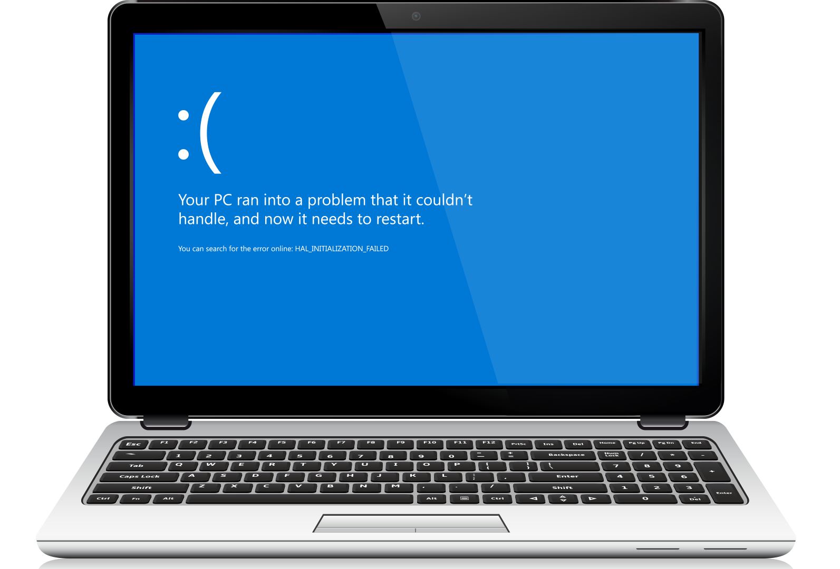

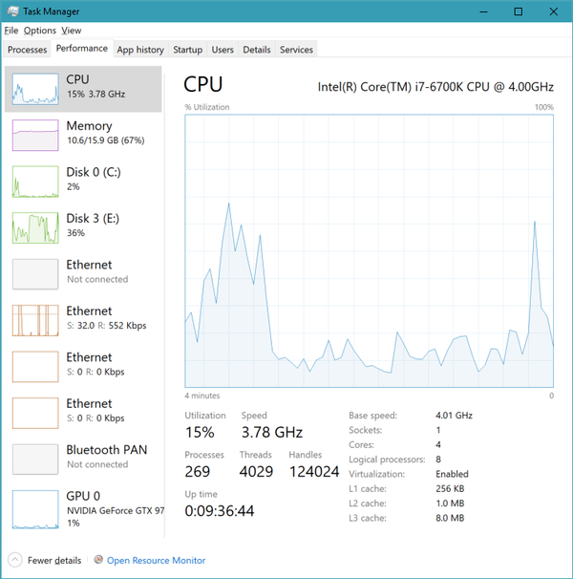
Task Manager
Task Manager is one of the most important Windows tools for troubleshooting resource usage.
We’ll audit and manage tasks and processes to identify errant or malicious actions taking place without users’ or administrators’ knowledge.
Processes in Windows are much like the processes and PIDs you saw in the Linux units.

Slide 14
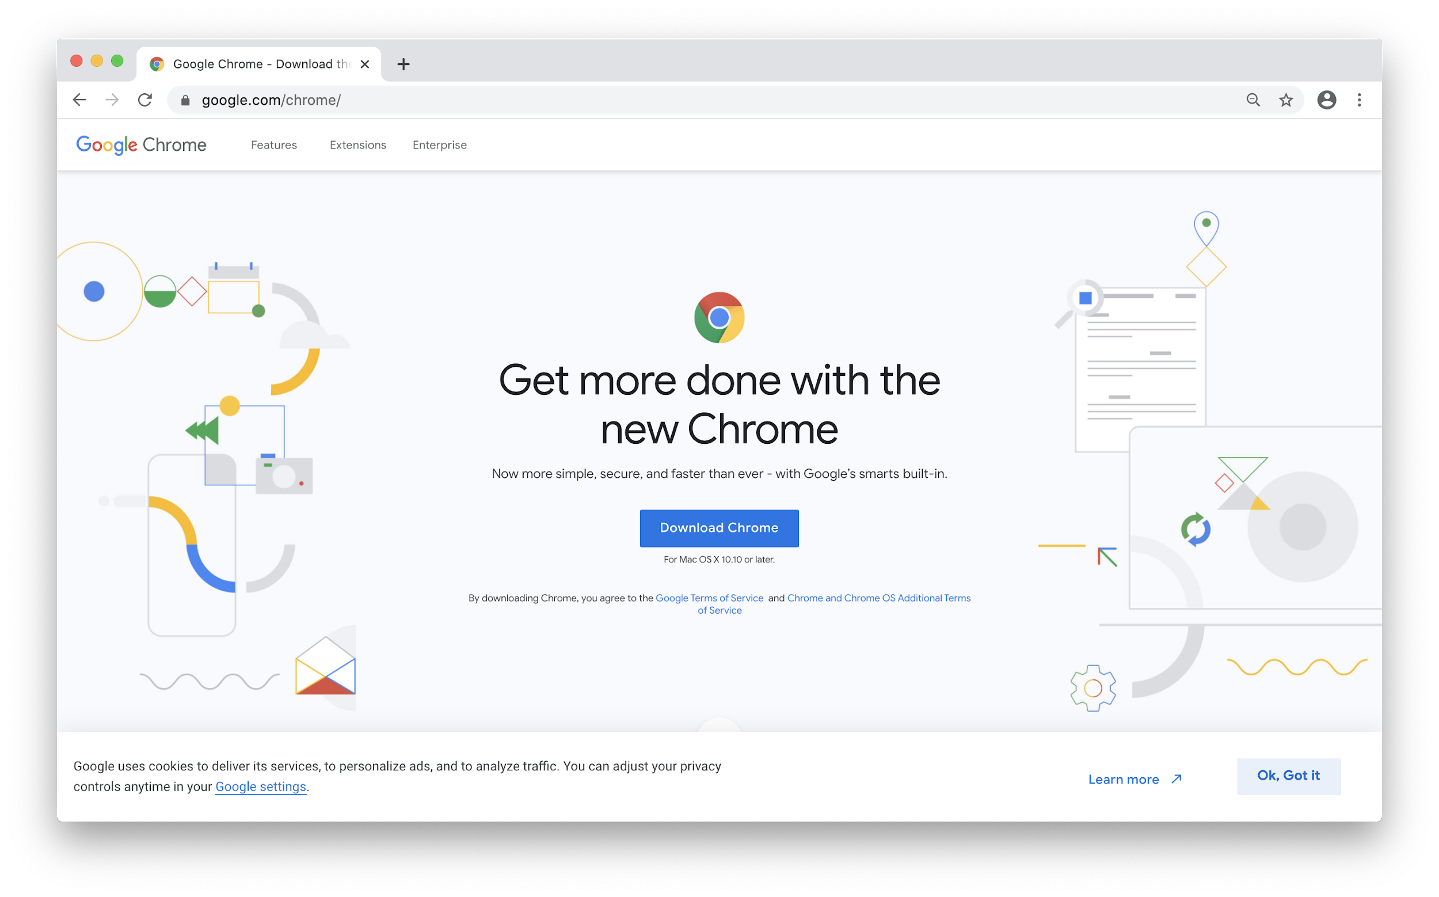
Task Manager
Some programs, if left running while not in use, can take up excessive resources or even allow for unwanted remote connections. Some examples are:
Google Chrome, which is well-known for its high memory usage.
Teamviewer, the remote desktop application, has had critical issues that have left systems extremely vulnerable, and accessible from public connections.
Notes:
Image sources; shutterstock_622218455 (laptop)

Slide 15
Task Manager
Some processes can even cause memory leaks that can result in system instability and abrupt system crashes.
When a Windows system crashes, you are often stuck with what what is known as the blue screen of death.
Notes:
Image sources: shutterstock_731181685 (screen); shutterstock_622218455 (laptop)

Slide 16
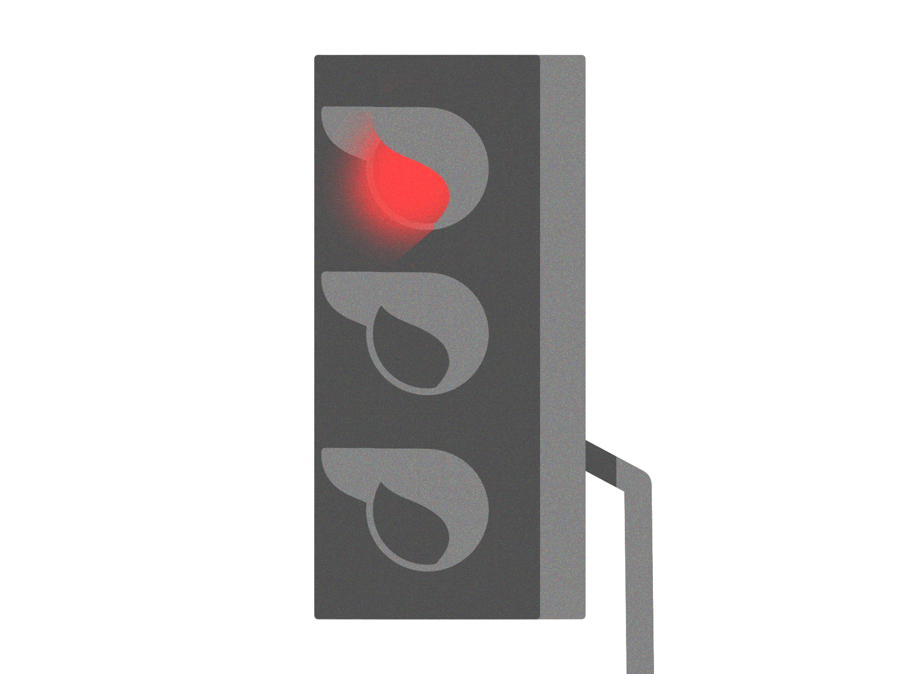
Let’s open up Task Manager, check out the processes, and end a process.
Notes:
Image source: Craig Allan

Slide 17
Task Manager and Ending Processes

Slide 18

Disabling Startup Applications (Task Manager)
Managing startup applications is important for system and security administration.
Startup applications can slow boot time due to their execution priority.
They may use excessive resources in the background, causing random system slowdowns.
They may use the network in the background. For example, they can initiate their own automatic updates, hogging network bandwidth but also become a security risk by opening ports to listen to.
They may require special permissions for their functionality. These can pose security risks if they are compromised through malware, which can then potentially run theses rogue processes as administrators
Notes:
Image source:

Slide 19
Introduction to Command Prompt (CMD)

Slide 20
Windows Directory and File Structure
The default Windows directory structure:
C:\
├── PerfLogs\
├── Program Files\
├── Program Files (x86)\
├── ProgramData\ [hidden folder]
├── Users\
│ └── [username]\
│ └── Desktop\
│ └── Documents\
└── Windows\
└── System32\
└── Config\
└── Drivers\
└── etc\
└──hosts
└──networks
└── Spool
└── Temp

Slide 21
Windows Directory and File Structure
The default Windows directory structure:
C:\ (or whichever drive Windows is installed on) is the root drive.
├── PerfLogs\
├── Program Files\ Where 64-bit applications are installed.
├── Program Files (x86)\ Where 32-bit applications are installed.
├── ProgramData\ [hidden folder] Where applications-specific settings reside.
├── Users\ Directory of all users (similar to the Linux /home directory).
│ └── [username]\ Each specific user’s home folder.
│ └── Desktop\ The desktop and document folders for the current user.
│ └── Documents\
└── Windows\ Holds Windows-specific programs and libraries.
└── System32\
└── Config\
└── Drivers\
└── etc\
└──hosts
└──networks
└── Spool
└── Temp

Slide 22

Remember environment variables from the bash programming unit?
In Windows, they work the same way— they’re preset by the system and usable in the command line and scripts.
Notes:
Image source: shutterstock_1451245511

Slide 23
Common ENV Variables
Environment variables (envvars) are special values that contain information about the system, such as the user's home directory or the system's program files directory.
Environment Variables | Default Value
%CD% | Current directory
%DATE% | Current date
%OS% | Windows
%ProgramFiles% | C:\Program Files
%ProgramFiles(x86)% | C:\Program Files (x86)
%TIME% | Current time
%USERPROFILE% | C:\Users{username}
%SYSTEMDRIVE% | C:\
%SYSTEMROOT% | C:\Windows
Envvars can be used for the following:
Shortening long directory paths.
Grabbing the current time.
Finding the location of your system files.

Slide 24
Common ENV Variables
Linux variables are designated with a $, while Windows ENV variables are enclosed with % signs.
Environment Variables | Default Value
%CD% | Current directory
%DATE% | Current date
%OS% | Windows
%ProgramFiles% | C:\Program Files
%ProgramFiles(x86)% | C:\Program Files (x86)
%TIME% | Current time
%USERPROFILE% | C:\Users{username}
%SYSTEMDRIVE% | C:\
%SYSTEMROOT% | C:\Windows
For example, to navigate to the 64-bit Program Files folder, we run:
cd %ProgramFiles%
We can combine ENV variables with regular directory names:
cd %USERPROFILE%\Desktop
This would send us to the desktop of the current user.

Slide 25
Common ENV Variables
We can combine environment variables with regular directory names:
Environment Variables | Default Value
%CD% | Current directory
%DATE% | Current date
%OS% | Windows
%ProgramFiles% | C:\Program Files
%ProgramFiles(x86)% | C:\Program Files (x86)
%TIME% | Current time
%USERPROFILE% | C:\Users{username}
%SYSTEMDRIVE% | C:\
%SYSTEMROOT% | C:\Windows
cd %USERPROFILE%\Desktop
USERPROFILE% is a variable assigned to the value of the current user's home directory.
This is the same as $HOME in Linux.

Slide 26
Command Prompt (CMD)
Windows Command Prompt (CMD or cmd.exe), is the command-line interface for Windows, comparable to a Unix shell, such as Bash for Linux.
CMD Command | Action | Linux Counterpart
cd or chdir | Change directory | cd
dir | List contents of directory | ls
md or mkdir | Create directory
copy | Copy file | cp
move | Move (cut and paste) files | mv
del or erase | Delete files and directories
rd or rmdir | Remove a directory if empty
find | Search a file for specified string
exit | Close CMD
type | Show contents of specified file | cat

Slide 27

Command Prompt (CMD)
Windows Command Prompt (CMD or cmd.exe), is the command-line interface for Windows, comparable to a Unix shell, such as Bash for Linux.
CMD Command | Action | Linux Counterpart
cd or chdir | Change directory | cd
dir | List contents of directory | ls
md or mkdir | Create directory
copy | Copy file | cp
move | Move (cut and paste) files | mv
del or erase | Delete files and directories
rd or rmdir | Remove a directory if empty
find | Search a file for specified string
exit | Close CMD
type | Show contents of specified file | cat
Note
Command prompts are not case sensitive with files and directories.
cd “Program files” is the same as
cd “PROGRAM FILES”
Use quotes around the name of a file or directory that contains spaces.
Notes:
Image source: AdobeStock_132309173

Slide 28

In the next walkthrough, we will create and manage files within Windows CMD.

Slide 29
CMD: Navigation and Output

Slide 30
Activity: Task Manager and CMD
In this activity, you will use CMD and Task Manager to output various details of a Windows workstation into a report file.
15 Minutes

Slide 32
Windows Management Instrumentation Command
(wmic)

Slide 33
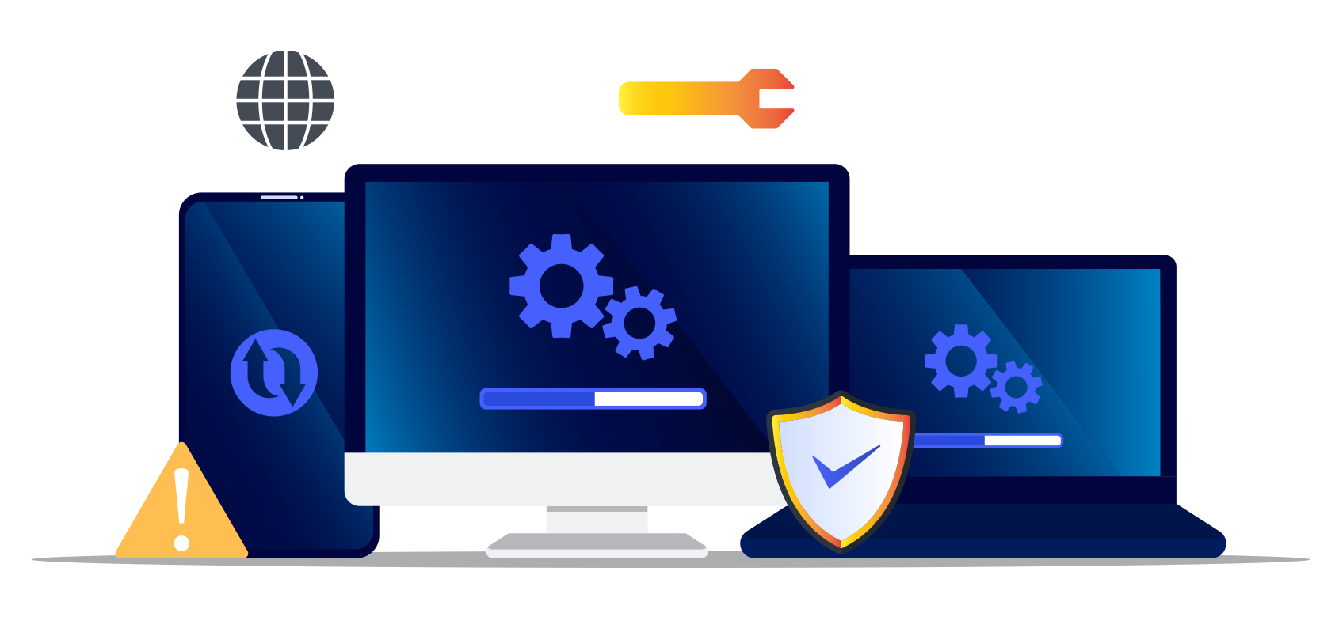
wmic
Windows Management Instrumentation Command (wmic) is a tool used to query system information and diagnostics, such as OS and hard disk info.
Sysadmins can also use wmic to launch, terminate, install, and uninstall processes.
Notes:
Image source: shutterstock_1458611168

Slide 34
wmic Structure and Conventions
wmic [global switches] [alias] [verbs] [properties]
[global switches] not to be confused with normal switches, are wmic-specific global commands that alter its behavior. They can do things like specify a file to append output to. Today, we will use the command /APPEND.
For example: wmic /APPEND:report.txt os get caption will append the Windows build number to the report.txt file.

Slide 35
wmic Structure and Conventions
wmic [global switches] [alias] [verbs] [properties]
[alias] is the Windows component that wmic queries. Common aliases include:
os (operating system): Contains properties specific to the operating system, such as the Windows edition name and build number.
Logicaldisk: Contains properties specific to the disk drives, such as drive name, file system, free space, size, and volume serial number.

Slide 36
wmic Structure and Conventions
wmic [global switches] [alias] [verbs] [properties]
[verbs] are actions we want to complete with the wmic command.
For example, if we are using wmic os to find operating system information, we can then use the get verb, followed by the various [properties] we want to find.

Slide 37
wmic Structure and Conventions
wmic [global switches] [alias] [verbs] [properties]
Common properties to retrieve using get:
get caption: Returns a one-line description of the given alias.
get /value: Gets all of the properties and values of an alias and lists each on separate line.

Slide 38

Applying wmic
Let’s walk through a few examples:
wmic os get /value
wmic os get caption, buildnumber
wmic /APPEND:report.txt os get caption
wmic logicaldisk get caption, filesystem, freespace, size, volumeserialnumber
wmic /APPEND:report.txt logicaldisk get caption, filesystem, freespace
Notes:
Image source: Rezo Bokaria

Slide 39

wmic Demo
In the next demo, we will move through different programs, understand their importance in a sysadmin context, and get and append them to our report.
We’ll retrieve the following properties from the startup alias:
Name/Caption: The name of each startup application.
Command: The execution path of the startup process.
User: The user that the startup application runs as on boot.
Notes:
Image sources: Nankeen (animation); shutterstock_622218455 (laptop)

Slide 40
wmic Demo

Slide 41
Activity: Creating a Report with wmic Output
In this activity, you will continue baselining the Windows system using wmic queries.
10 Minutes

Slide 43
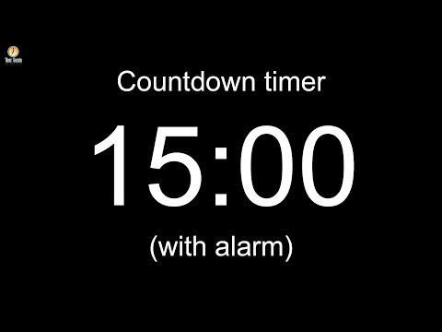
43
Notes:
Image source: AdobeStock_56885471

Slide 44
Users and Password Policies

Slide 45

Next, we’ll use the command-line tool net to manage user accounts, groups, and password policies.
Notes:
Image source: shutterstock_1149661154

Slide 46

Using net
We’ll be using the following net utilities:
net user for adding, removing and managing users.
net localgroup for adding, removing, and managing local groups.
net accounts for viewing password and logon requirements for users to enforce password security policies.

Slide 47



Using net
net lets us set the following password policies:
Number of times a password must be unique before it can be reused again.
If using the password apples2apples, you’ll have to change it to two new passwords before you can use apples2apples again.
Time before a password expires.
Minimum number of characters required for a password.
Minimum number of days before a password can be changed.
Notes:
Image source: rshutterstock_1193967568

Slide 48
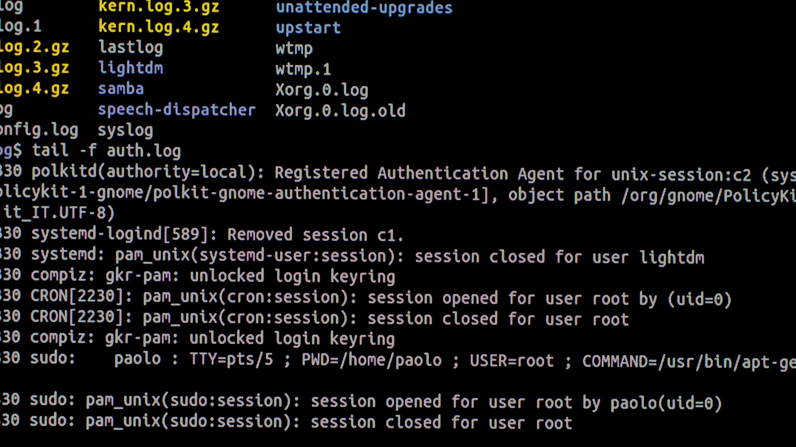
net Demo Scenario
Your CIO is curious about the groups and password policies on the Windows workstation. We need to retrieve more information from this workstation using the net command-line utility.
We’ll use the net tool to do the following:
Enumerate users to see net output.
Enumerate azadmin’s groups and password policies.
Enumerate local groups with net localgroup.
Enumerate the Windows workstation's current password policies with net accounts.
Notes:
Image source: shutterstock_705318595

Slide 49
net

Slide 50
Activity: Users, Groups and Password Policies
In this activity, you will use the net utility to retrieve more information about the Windows workstation.
10 Minutes

Slide 51
Creating Users and Setting Password Policy

Slide 52
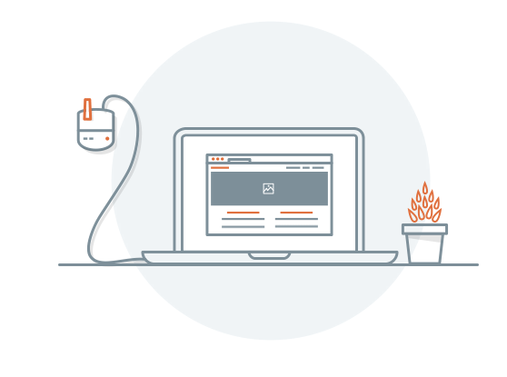
Password Policies
We’ve discussed the importance of password policies in earlier Linux units. Now we’ll establish password policies for new users in Windows.
In the next demonstration, we’ll use the following scenario:
A new regular user (Barbara) and new administrator (Andrea) need to be added to the workstation.
We’ll use net user to create user accounts for Andrea, the new senior developer, and Barbara, the new sales representative.
We will create these users and set their password policies to make sure they follow company wide policies.
Notes:
Image source: Dion Pramadhan

Slide 53
Adding Users and Setting Password Policies

Slide 54
Activity: Create Users and Set Passwords
In this activity, you will create users and set password policies for two new users.
10 Minutes

Slide 56
Task Scheduling
(Optional / Time Permitting)

Slide 57

Task Scheduling
Task Scheduler is a GUI tool that allows system administrators to automate the execution of scripts and applications on a Windows system.
Similar to cron jobs, tasks can be set to execute at specific times, or a certain amount of time after a user logs in.
Properly managing systems with scheduled tasks allows us to automate security and system administration actions such as checking for updates for endpoint security software, sending important logs to systems such as SIEM, and scheduling system maintenance scripts.
Notes:
Image source: Dan Sams

Slide 58
Task Scheduling Demo Setup
In this demo, we will use the administrative user, Andrew, to create scheduled tasks that will automate the reports we've been working on.
The CIO wants us to schedule reports to be created on a daily basis.
We will use Task Scheduler to create a task that runs each day.
Notes:
Image source: shutterstock_705318595

Slide 59
Activity: Task Scheduling
In this activity, we will use Task Scheduler to schedule reports to be created every day.
10 Minutes

Slide 61
⚠️ Important ⚠️
Make sure to shut down your Windows RDP Host Machine.
You are provided 30 hours of Azure lab access. If you exceed that quota, you will be provided an additional 10 hours. If you exceed those additional hours, you will be provided an additional 5 hours.
Once you exceed that final quota, you will not be provided any additional hours. It is extremely important that you preserve your allotted hours by shutting off your machines at the end of each class.

Slide 62
Any Questions?

